Slide 1
Airway Expander for Subglottic Stenosis Progress Report
Group 33 – Kyle Sachdev, Brian Dallesasse, Taylor Hughes
Client – Dr. Randal Paniello
Section 3
December 5, 2016

Slide 2
Updated Project Scope
Narrowing of the trachea at the cricoid cartilage
Focus on grades II and III
Current treatment has a high rate of re-scarring
Goal is to produce a solution that decreases the likelihood of re-scarring
Development of prototype

Slide 3
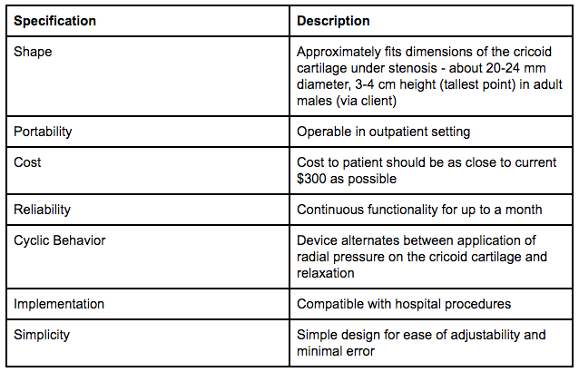
Design Specifications

Slide 4
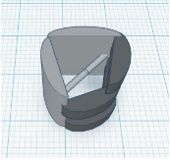
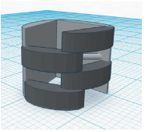
Design Alternatives – Claw
Claw Shape with posterior hinge
Linear actuator forces open
Wired to external controller through incision in the neck

Slide 5
Design Alternatives – Adapted Claw
Linear actuator is replaced by titanium bar
Track on inner face of claw
External rotating motor attached to titanium bar through incision
Rotation of motor pulls bar forward

Slide 6
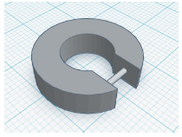
Design Alternatives – Flexible Ring
Flexible ring with screw
Rotation of screw leads to expansion/relaxation
Need an internal motor to rotate screw
Motor wired to external controller through incision

Slide 7
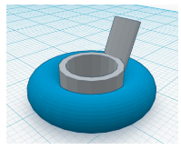
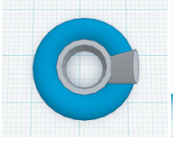
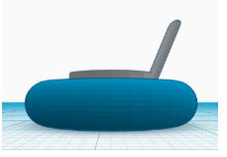
Design Alternatives – Toroidal Balloon
Toroidal Balloon wrapped around the ring
Operate similar to current catheterization procedure
Tubing connects external pump to balloon through an incision
Pump forces saline into balloon at regular intervals

Slide 8
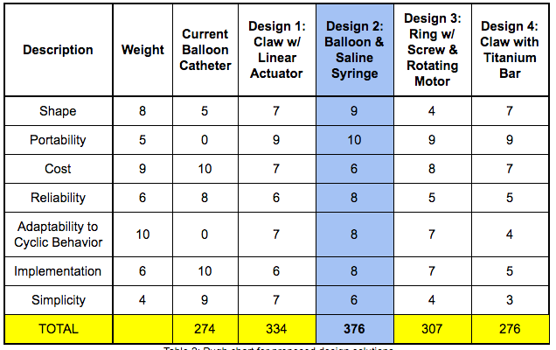
Design Analysis

Slide 9
Overview of Chosen Solution
The inner ring will be 3D printed from ABS
Toroidal Balloon will be a balloon catheter wrapped around ring
External syringe pump with linear actuator to move syringe
Arduino
Powered by 12V battery

Slide 10
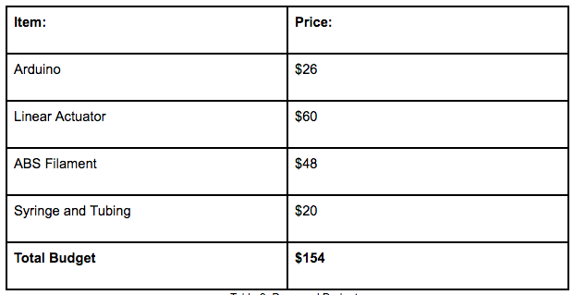
Proposed Budget

Slide 11
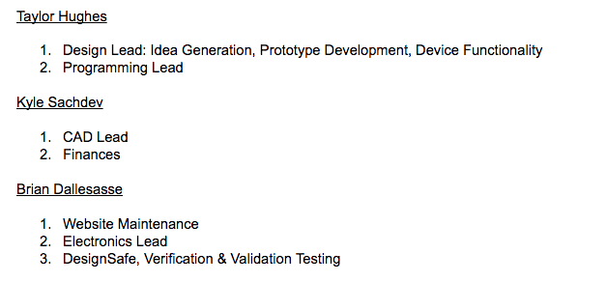
Updated Team Responsibilities

Slide 12
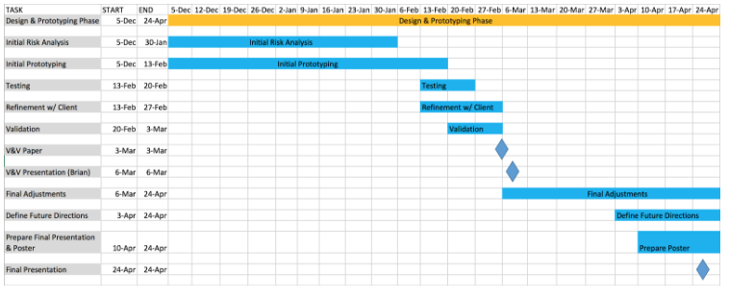
Design Schedule

Slide 13
Questions?

Slide 14
References

