Slide 1
Application of Cyclic Stress for Treatment of Subglottic Stenosis
Verification & Validation Report
Group 33: Brian Dallesasse, Kyle Sachdev, Taylor Hughes
Client: Dr. Randal Paniello
March 6th, 2016

Slide 2
Review of Project Scope
Obstruction of airway at cricoid cartilage due to scar tissue
Current treatment is unreliable and has a high rate of re-scarring
Develop a device that significantly decreases the likelihood of re-scarring
Patients with tracheostomy tube
Notes:
Shorten
*Point out figures
Subglottis, lower portion of larynx: area beneath vocal cords and above top of trachea
-Scar tissue build up typically from intubation (facilitate ventilation in critically ill patient)
(Don’t need) - Current treatment: procedure with laser incision in scar tissue, insert balloon catheter (~8 cm long), pump up with saline to force scar tissue out of airway, repeat 2-4 times
patient typically returns for same procedure within 6 months
probably don’t have to mention details due to time
Design a device that decreases likelihood of scar tissue reformation, increasing patients quality of life, saving time and $$
Target - patients w/ tracheostomy tube – critical because our device will not be relied on for breathing purposes – adds a huge layer of special consideration to design
(optional) tube below affected area (see image)
speech: air can bypass with special valves in trache design or patient can cover trache opening for speech
aka speech definitely possible for tracheostomy patients

Slide 3
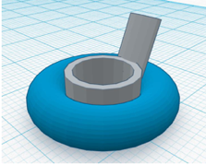
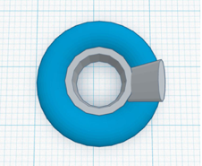
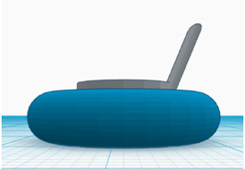
Device Design
Long-term intermittent application of stress on scar tissue
Toroidal Balloon wrapped around solid ring
Arduino microcontroller
Linear actuator acts on syringe to pump saline in & out through tubing connected to balloon
Notes:
GENEARALLY SPEAKING without dimensions or pressure values (get to those in design specs and V&V)
Long-term – treatment continues outside clinic
First just state basic components
Balloon structure shown is in vivo
Arduino circuitry/syringe pump is ex vivo
Working all together
arduino easily programmed with frequency at which liquid (water/saline) pumped in and out
linear actuator acts on a syringe to inject & extract the saline
tubing runs up to airway where it fills balloon
10 minute pressure period, 5 minute relaxation period
Critical part of design!
make sure to highlight relaxation period!
relaxation period allows for reperfusion, blood flow back to surrounding tissue (prevent damage due to consistent, applied pressure)
LONG TERM
intermittent pressure on scar tissue – better chance at keeping it out of airway

Slide 4
Design Specifications
Specification | Description
Pressure | Between 3-7 atm
Shape | Approximately fits dimensions under stenosis – about 10-12mm diameter, 3-4 cm height (adult males as reference)
Portability | Device is self-contained; patient is able to perform daily activities w/ few restrictions
Cost | Cost to patient ≤ $300
Reliability | Continuous functionality without intervention, up to a month
Cyclic Behavior | Alternates between application of radial pressure & relaxation – tuneable by physician
Implementation | Compatible w/ hospital procedures (i.e. sterile field, ability to be stocked safely, useable by trained otolaryngologists)
Air passage | Device allows enough air to pass through to vocal cords for speech
Notes:
Changes in specifications
addition of pressure
Switched simplicity (too vague) for air passage
no particular order of importance
*Don’t need to explain design specifications here
Pressure – approximate via current treatment procedures
Shape – deflated balloon should fit dimensions
Portability – since long term, operable in outpatient setting
Reliability – function w/out user intervention
Cyclic behavior – intermittent pressure application (current frequency set at 10 min pressure, 5 min relaxation)
Implementation – sterilizable, physician able to insert
Air passage – current trache patients can allow to vocal cords for speech, so device should not interfere with that

Slide 5
Verification - Pressure
Polyvinyl chloride (PVC) thermofilm – balloon material
Barlow’s formula – maximum internal pressure of balloon
P=2St/D =2 (244 atm)(0.038 mm)/(5 mm)=3.71 atm
Fill balloon, place weight on top, estimate pressure
Force/Surface Area
Design Specification
Pressure | Between 3-7 atm
Notes:
What is the pressure applied when balloon actually functioning
what is it doing to the tissue
basic model, some kind of cylinder
look into animal models
Pressure spec - 3-7atm is the typically range of pressures generated by current catheter dilator treatments
better to keep on lower end in beginning to stay on safer side
maintain structural integrity of cartilage
PVC – commonly chosen in medical device industry – high tensile strength, easily molded, biocompatible
HOW DO WE VARY PRESSURE– just add/subtract saline
S – allowable stress of material – characteristic value
T is thickness of film
D is internal diameter of expanded balloon
Lower pressure better so not applying high long term on cartilage, decreasing its support and integrity

Slide 6
Verification - Shape
Measure dimensions by hand
Possible 3D model of cricoid cartilage w/ SGS from client
Deflated balloon should fit these dimensions
Posterior support or suture to neck to prevent slippage
Design Specification
Shape | Approximately fits dimensions under stenosis – about 10-12mm diameter, 3-4 cm height (adult males as reference)
Notes:
Balloon in its deflated state needs to fit balloon
Dimensions given are a reference, obviously everyone will be slightly different
Inflated balloon bigger for obvious reasons, push scar tissue out of airway
Approximate dimensions
obviously every patient will vary slightly, but this is proof of concept
Posterior support to prevent slippage
Client also mentioned can possibly suture to neck
suture likely more feasible & reliable option
Don’t Squash vocal cords!

Slide 7
Verification – Portability & Cost
Attach exterior portion of device to belt and perform basic daily activities such as walking, bending over, pickup light objects
Current cost of materials to build prototype ~$85
Research markup by clinic, less than $300 total (cost of balloon catheter procedure)
1 time cost vs multiple $300 payments
Design Specification
Portability | Device is self-contained; patient is able to perform daily activities w/ few restrictions
Cost | Cost to patient ≤ $300
Notes:
Portability of in vivo portion a test for a later, more developed state
Unsure how clinics price procedures/devices, but estimating it will be within target – discuss with current physicians

Slide 8
Verification – Reliability & Cyclic Behavior
Run device continuously for a day to few days to make sure no intervention required
Cyclic behavior already proven with Arduino & linear actuator connection
10 minutes stress, 5 minutes relaxation
Frequency easily adjustable w/in Arduino code
Design Specification
Reliability | Continuous functionality for up to a month
Cyclic Behavior | Alternates between application of radial pressure & relaxation – tuneable by physician
Notes:
Reliability - do calculation for power supplied by 12V battery
voltage discharge/consumption calculation
Cyclic frequency: discussion with client to come up with reasonable starting point
current balloon catheter procedures apply pressure for a few minutes, but only shortened because patient needs oxygen
explore increasing relaxation time
Okay to say client specified starting point for frequency

Slide 9
Verification – Implementation & Air Passage
Discuss device insertion w/ trained otolaryngologist to verify
Flow calculation
Normal speech production, Re>1800 for vocal tract
Re=Uh/A𝜈=(600 L/min)(1 cm)/(0.785 cm2)(0.15 cm2/s)=5095
Design Specification
Implementation | Compatible w/ hospital procedures (i.e. sterile field, ability to be stocked safely, useable by trained otolaryngologists)
Air passage | Device allows enough air to pass through to vocal cords for speech
Notes:
PEFR calculation is pretty much our verification step
*figure out variables in PEFR
will a 1 cm opening be enough to product speech
h – characteristic dimension – diameter of opening
PEFR w/out obstruction – lab test that they do in a hospital (for 40 year old male)
A – cross sectional area of opening
nu – flow property of air – viscosity

Slide 10
Validation
Would require real user operation to test its ability to adequately widen airway w/ SGS
Not feasible – requires strict approval for implementation
Need 3D that approximately reflects conditions of airway stenosis
Notes:
(look up validation definition again to use for explanation)
Product fulfills requirements of intended use
Construct model to simulate conditions of stenosis
Look into animal models – note it’s a big option
not critical
Outcome - % of stenosis decreased
Where on body connected to – chest/shoulder/back/etc
Detachable for shower/sleeping?

Slide 11
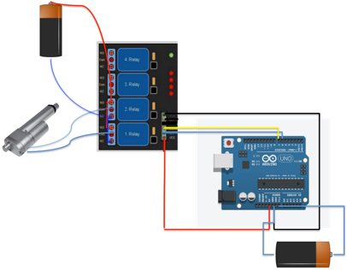
Proof of Concept – Syringe Pump
Mock up of syringe pump control circuit shown
Linear actuator controlled by an Arduino through a relay board
Arduino code programs frequency of syringe pump
Unloaded actuator moves at 5.7mm/sec
Flow rate of 0.28mL/sec when actuator loaded w/ 5mL syringe
No data yet on time to inflate/deflate balloon
Notes:
Proof of concept via circuity connection
How does the actuator pull on the syringe? – glued to it
Microcontroller can’t provide high voltage/current actuator needs, thus the relay board
relay board also allows a switch in polarity (switch direction of actuator push/pull)
Inflate/deflate times may factor into frequency of applied/relaxed pressure
Use measured data to better understand how to control / tune applied pressure
Include video if possible

Slide 12
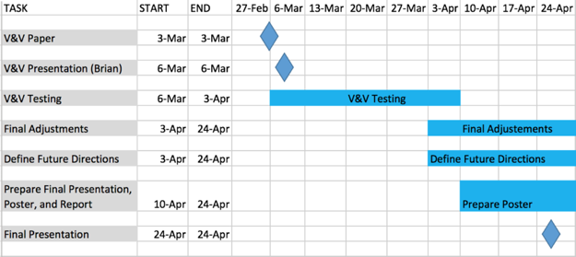
Project Status
Possess all foundational design elements (control circuit, syringe, balloon material, printing filament)
Exterior design elements working
Begin prototype assembly this week
No change in team responsibilities
Budget - $20 remaining
Linear actuator - $55
Relay board - $10
Balloon material - $20
Gantt Chart for Remaining Schedule
Notes:
Have all the pieces, we have constructed external components, need to make the balloon and attach to begin testing and refining

Slide 13
Questions?
Notes:
With that I’d like to thank everyone for listening and welcome any questions you may have

Slide 14
References
Paniello, Randal. Personal Interview. 27 Oct. 2016.
Kent, R.D. “Vocal Tract Acoustics” Journal of Voice. 7(2):97-117

